Slide 1
Understanding Index Bloat in SQL Server
✅ What is Index Bloat in SQL Server?
🔹 Definition:
Index bloat refers to the excessive growth or inefficient usage of index pages over time, caused by actions like inserts, updates, and especially deletions.
This leads to:
Wasted space in index pages (low page utilization)
Increased I/O during reads and scans
Higher fragmentation

Slide 2
Think of It Like This: A Book Example
📚 Imagine you're reading a dictionary.
Every page has words listed alphabetically—this is like an index.
Normally, each page is full of words, so you can find what you need quickly.
🔄 But over time...
Someone erases words from many pages (like deleting rows in a table).
Now, you flip to a page and see only one or two words.
Some pages are even blank.

Slide 3
❗ The Problem
The dictionary still has the same number of pages.
It takes longer to search through.
You’re carrying a thick, heavy book, but most pages have little or no info.
📖 That’s Index Bloat in SQL Server:
Book Analogy 🧾 | SQL Server Equivalent 🗃️
Dictionary pages | Index pages
Words on the page | Index entries (row pointers)
Erased words | Deleted rows
Thick but empty book | Bloated index (wasted storage)
Slower page turning | Increased I/O and slow performance

Slide 4
Optimizing SQL Server Indexes by Removing Empty Pages
How Empty Pages Are Created ?
Over time, especially with frequent DELETE or UPDATE operations:
Rows get removed from index pages.
These pages are not automatically removed or compacted.
As a result, SQL Server ends up with partially filled or completely empty index pages.

Slide 5
Before and After Deletion
🔵 Before Deletion – Index Pages Are Full
Clustered Index (Page Level Layout):
[Page 1] --> Row1, Row2, Row3
[Page 2] --> Row4, Row5, Row6
[Page 3] --> Row7, Row8, Row9
Index pages are fully utilized.
Data is stored in a balanced B-tree structure.

Slide 6
After Deletion – Empty Pages Exist
[Page 1] --> Row1 (only 1 row left)
[Page 2] --> Row4, Row5 (Row6 deleted)
[Page 3] --> (EMPTY) --> All rows deleted
Page 3 is now empty but still exists in the structure.
It consumes space and is still scanned during read operations.

Slide 7
Why Empty Pages Are a Problem?
🔍 Issue | 💥 Impact
More pages to read | Slower queries, more I/O
Waste of storage | Less efficient use of disk
Fragmentation | Degraded index performance

Slide 8
🛠 Tools for Cleanup
Tool | Description | When to Use
DBCC SHRINKDATABASE | Shrinks database files, returns free space to OS | After mass deletion
ALTER INDEX REORGANIZE | Defragments leaf-level pages in small chunks | For light fragmentation (10–30%)
ALTER INDEX REBUILD | Drops and recreates the index | For heavy fragmentation (>30%)
sys.dm_db_index_physical_stats | DMV that shows page count, fragmentation %, space usage | To analyze index health

Slide 9
Generating The Scenario
In this scenario, we created a table named “Object” inside the database “TestSizeDB”, which contains three columns: “Id”, “Name”, and “Shape_Xml.” The “Shape_Xml” column stores XML data, with each row containing over 2.5MB of XML to increase the overall database size to over 1GB.
The “Id” column is defined as the primary key, which causes SQL Server to automatically create a unique clustered index on it. Additionally, we created a non-clustered index on the “Name” column.
Initially, the table contained 500 rows. We then deleted 250 rows to test the scenario, after which we shrunk the database and reorganized the indexes on the table.

Slide 10
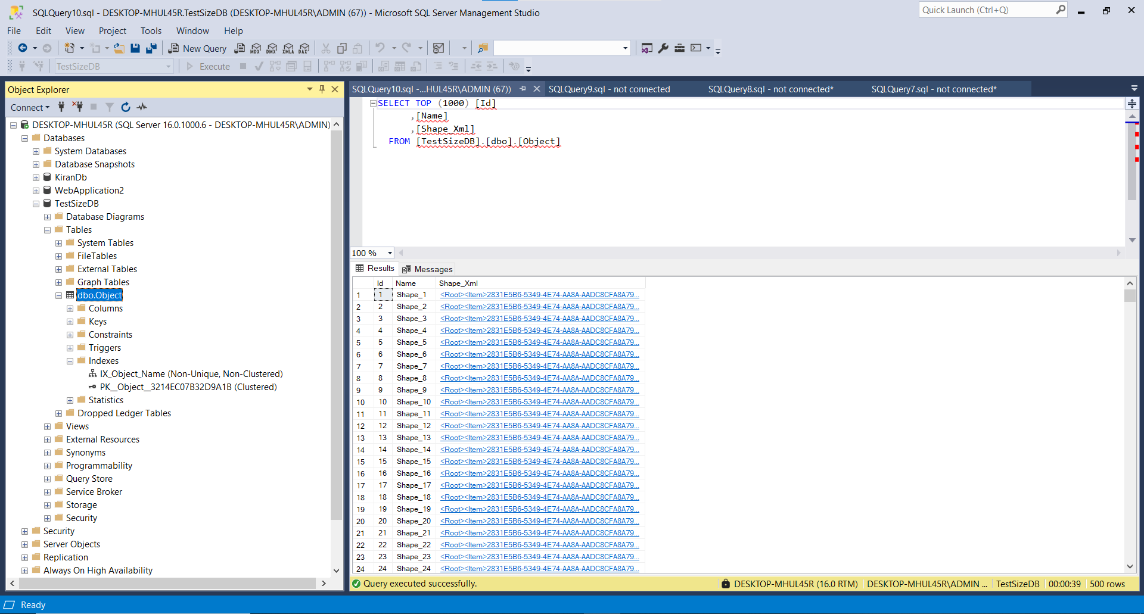
Object Table

Slide 11
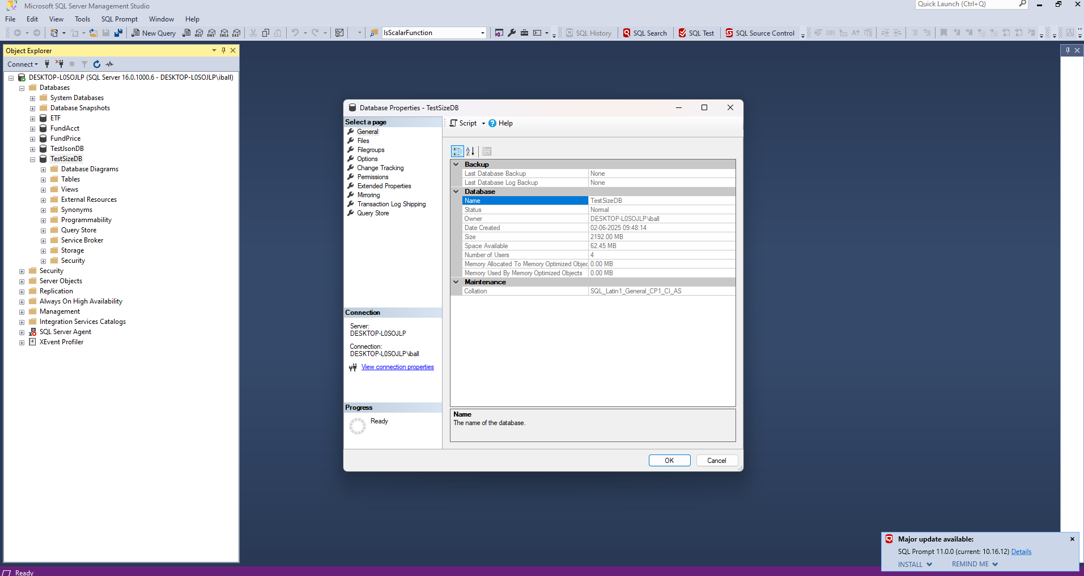
Before Deletion Table Size

Slide 13
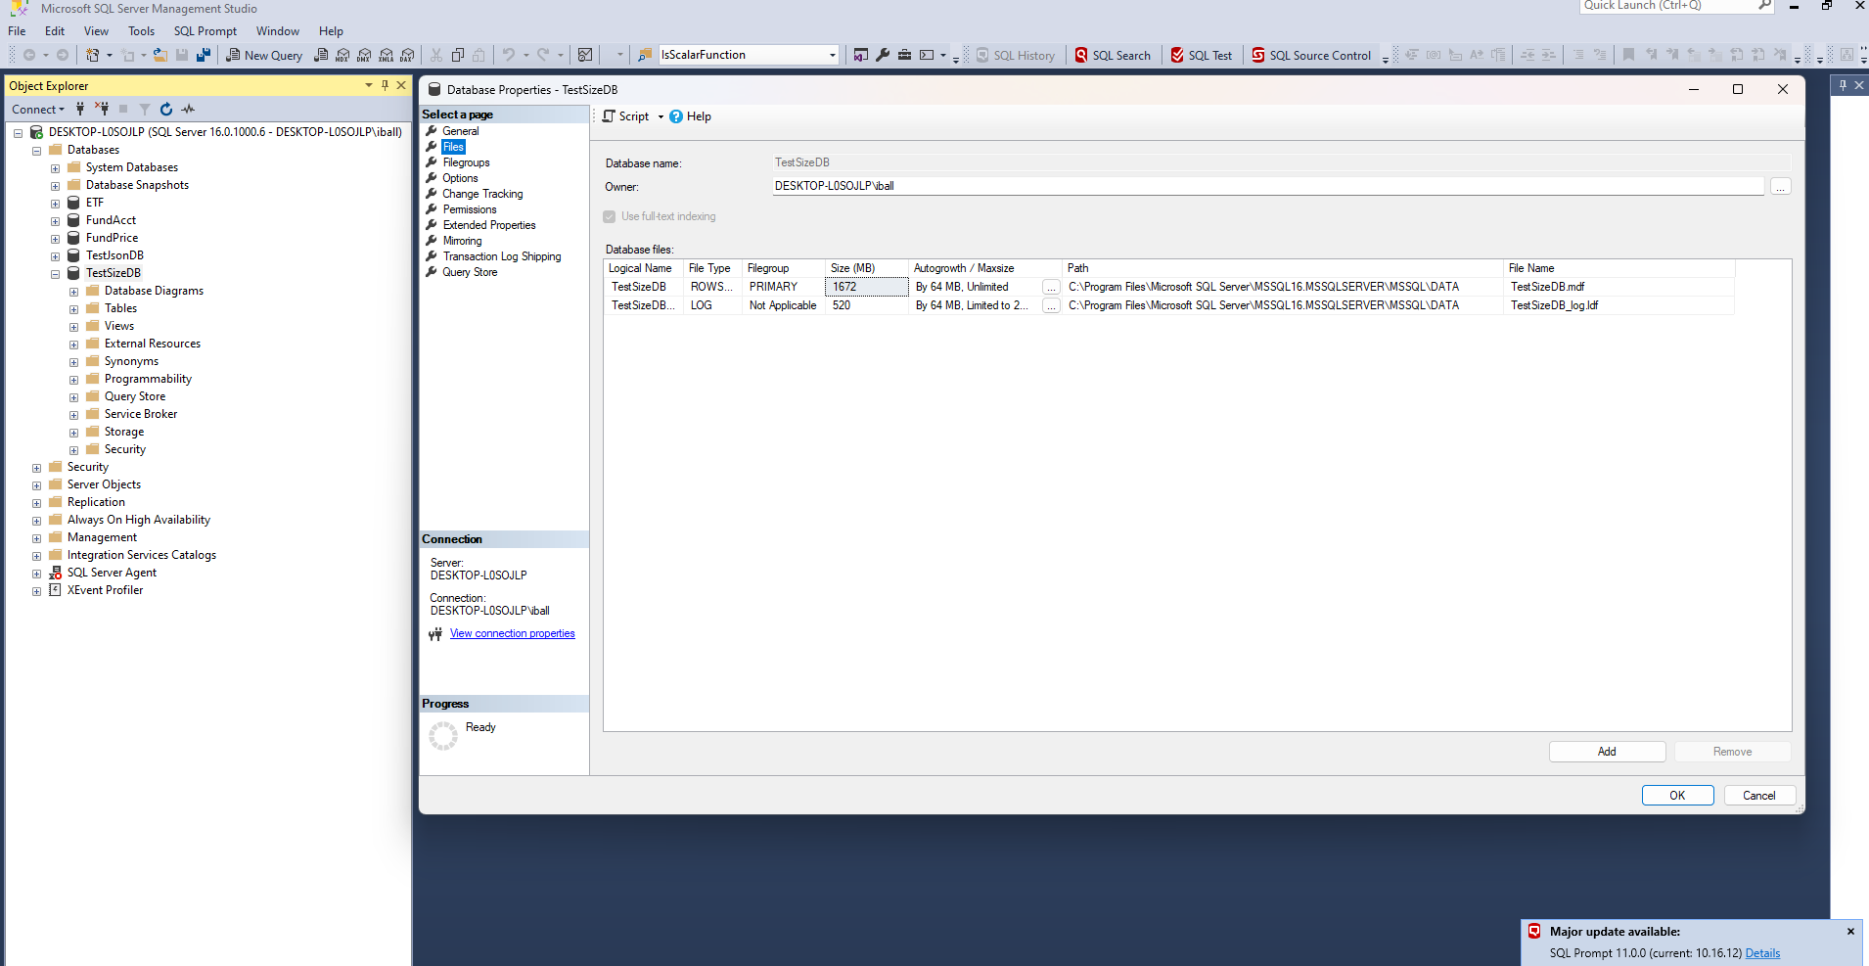
Database Files

Slide 14
📁 MDF File (Primary Data File)
Full form: Master Data File
Purpose: Stores the actual database data — tables, indexes, stored procedures, views, triggers, etc.
Default extension: .mdf
Always required: Every SQL Server database must have exactly one primary .mdf file.
Contents:
  System tables and user tables
  All data and metadata
  Filegroup information
📌 Example:
MyDatabase.mdf

Slide 15
📁 LDF File (Log Data File)
Full form: Log Data File
Purpose: Stores the transaction log, which records all changes made to the database — insertions, updates, deletions — to support recovery and rollback.
Default extension: .ldf
Critical for recovery: SQL Server uses this file to recover a database to a consistent state in case of a crash or restore operation.
📌 Example:
MyDatabase_log.ldf

Slide 16
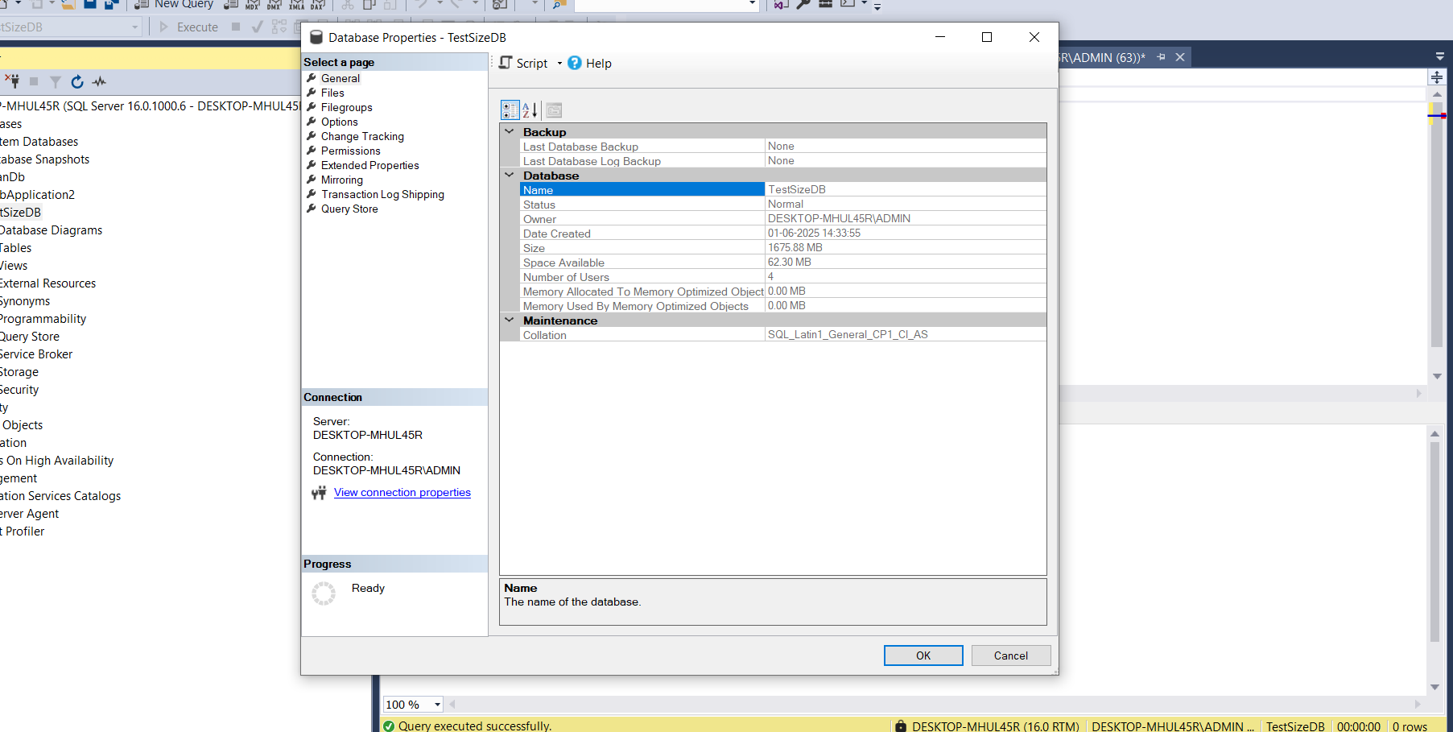
Before Deletion Database Size

Slide 17
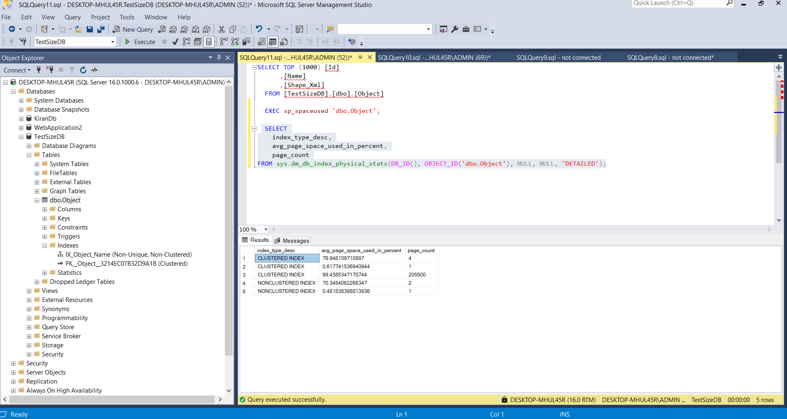
Before Deletion Indexing Status

Slide 18
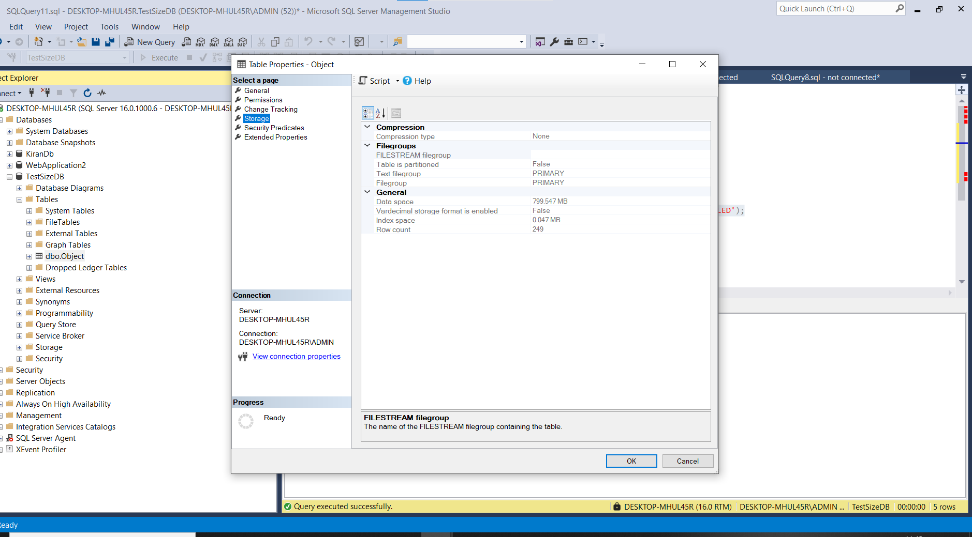
After Deletion Table Size

Slide 19
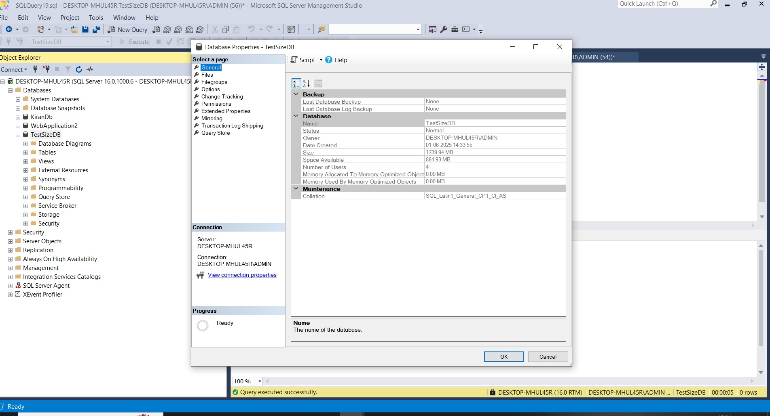
After Deletion Database Size

Slide 20
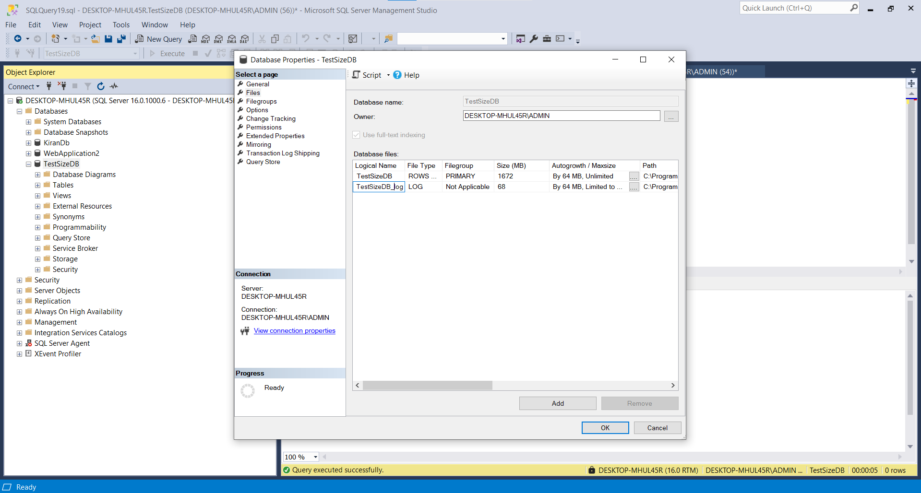
After Deletion Database Size

Slide 21
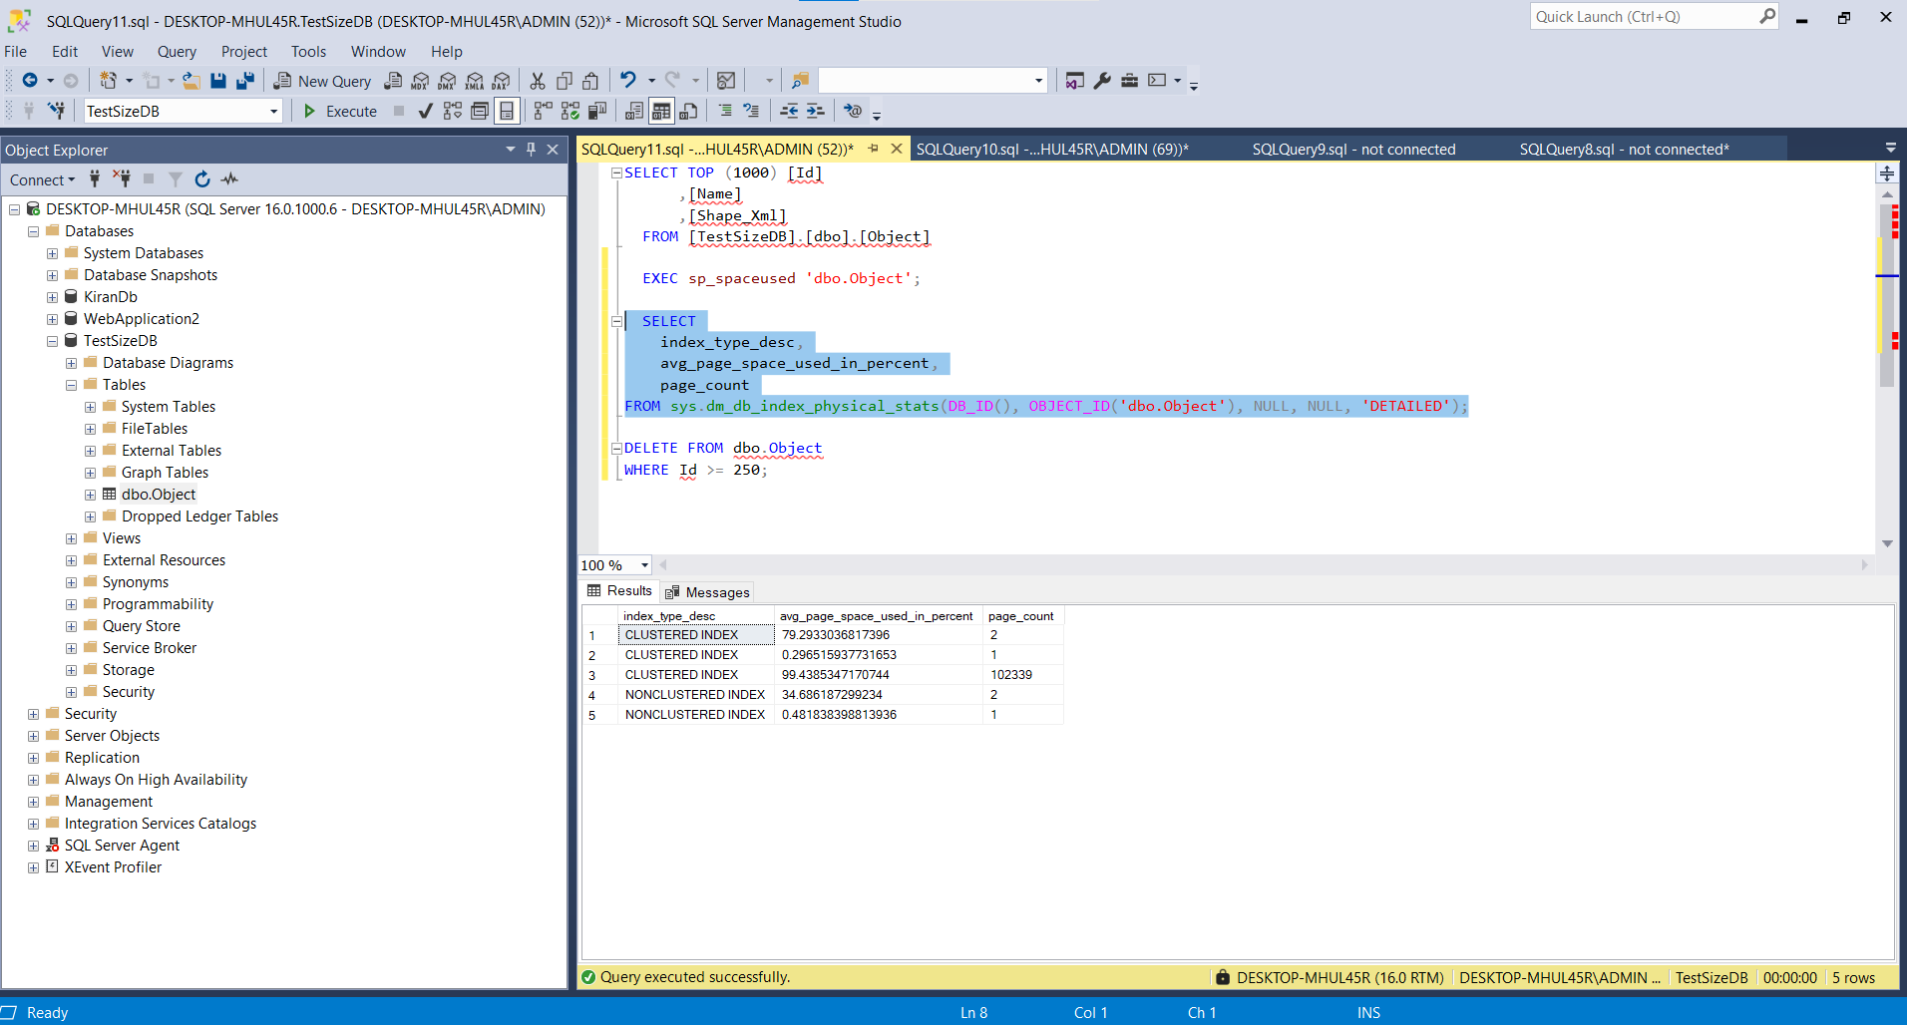
After Deletion Indexing Status

Slide 22
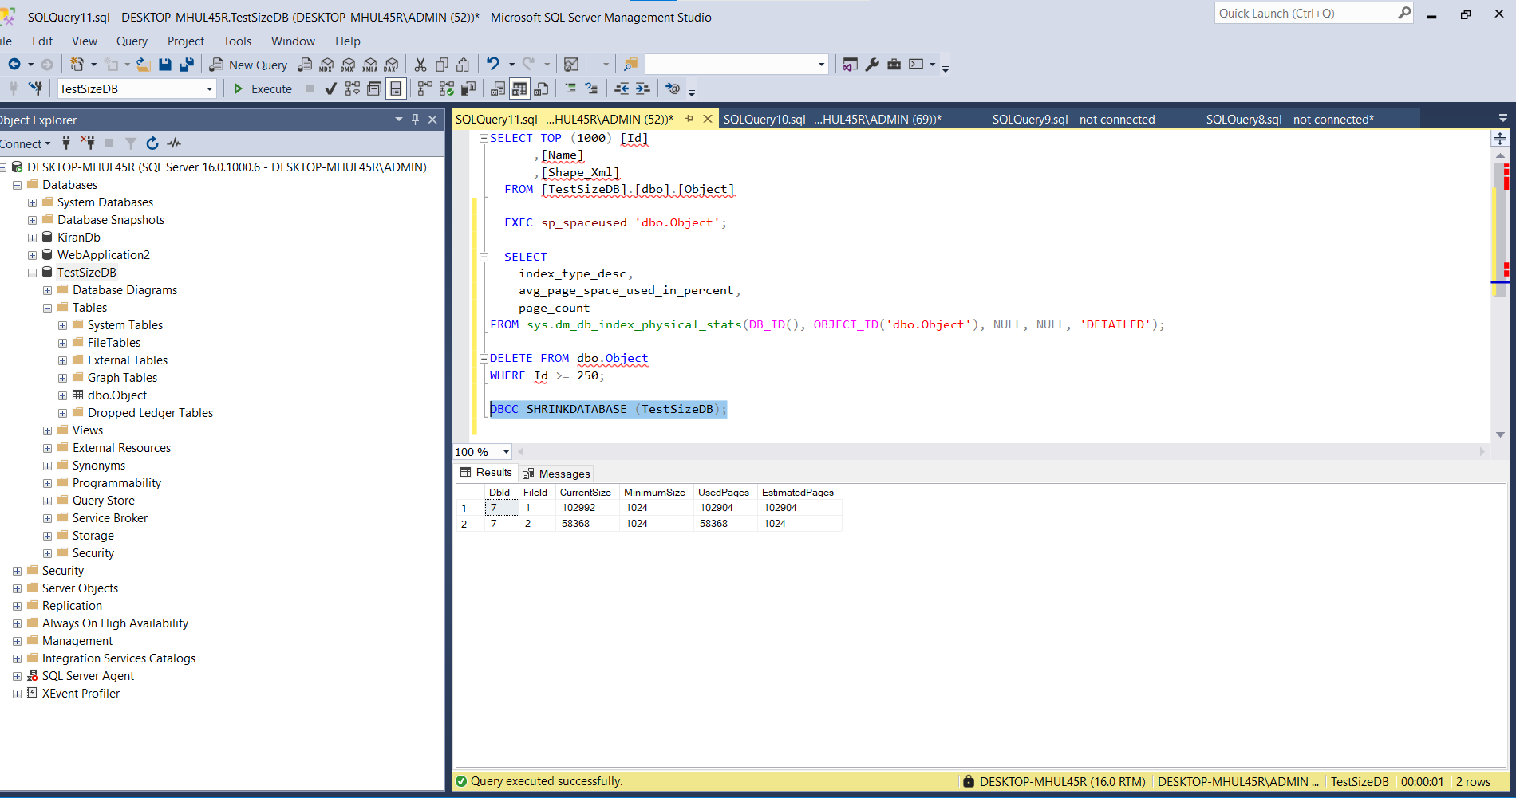
After Applying Shrinking Database Command

Slide 23
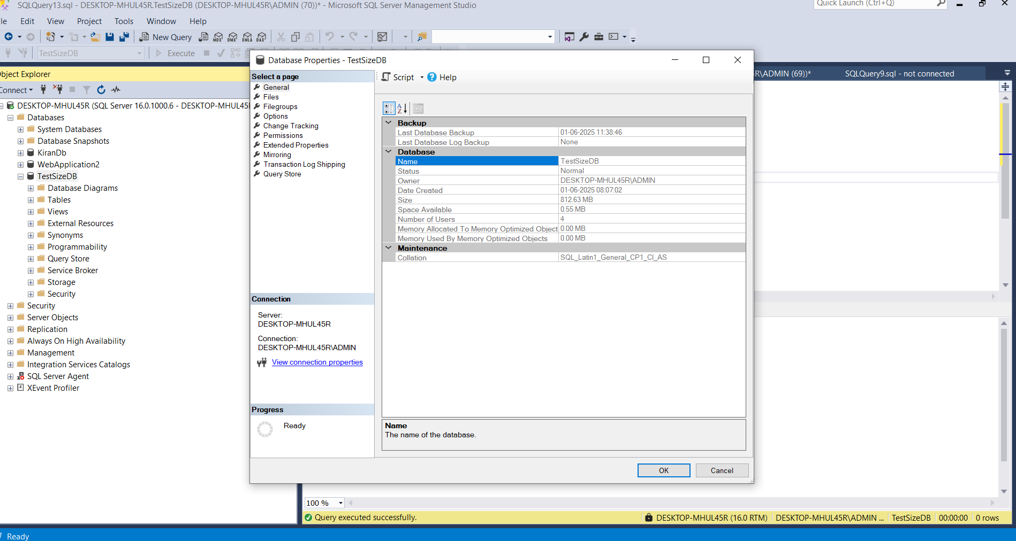
After Shrink DataBase Size

Slide 24
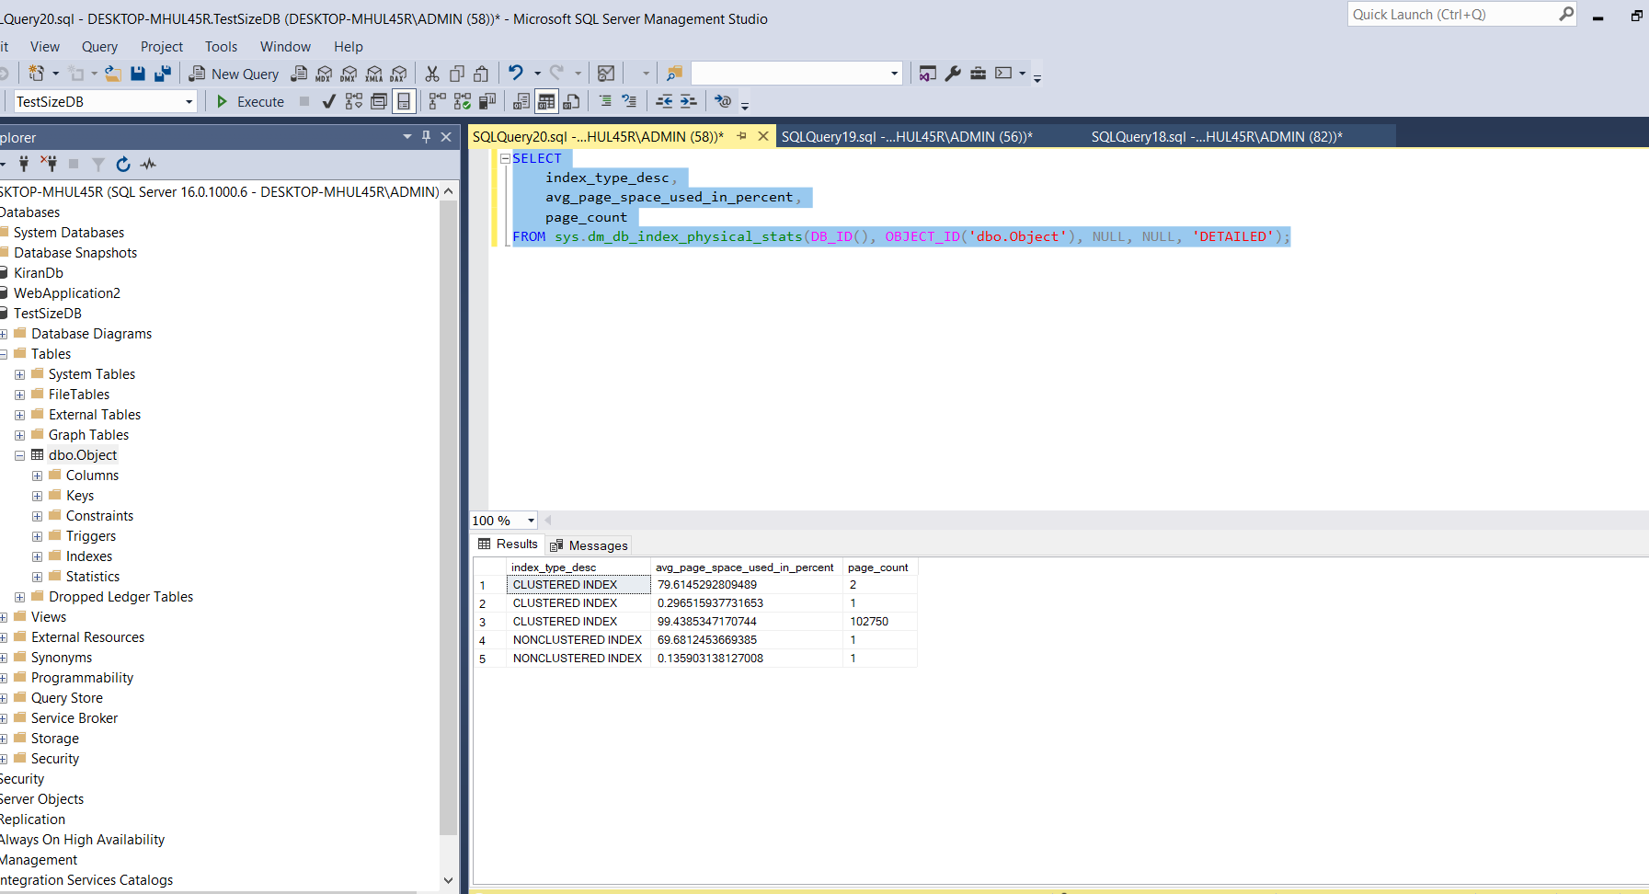
After reorganize all command

Slide 25
Conclusion
✅ In this scenario, after deleting data and performing a database shrink, we observed a significant drop in the page_count value, confirming that physical space was reclaimed. However, this also introduced index fragmentation, as shown by reduced avg_page_space_used_in_percent and uneven page utilization.
To mitigate the performance impact of this fragmentation, we executed the ALTER INDEX ... REORGANIZE command, which helped compact index pages and improve their efficiency without fully rebuilding the index.
🔹Shrinking reclaimed space,
🔹Reorganizing optimized the index layout,
🔹 Together, they balanced space savings and performance recovery.
Recommendation: After shrinking operations, always follow up with index maintenance (either reorganize or rebuild, depending on fragmentation level) to maintain query performance and storage efficiency.

